Slide 1
Introduction

Slide 2
Semester C - Rationale
Provides competitive edge for business analysis and software development by imparting knowledge on various modeling techniques.
Builds a strong foundation for the construction of websites that also facilitates online transaction processing.
Provides knowledge on optimizing the source code or the algorithm that can improve the application performance.
Notes:
Explain the rationale of this semester to the students.

Slide 3
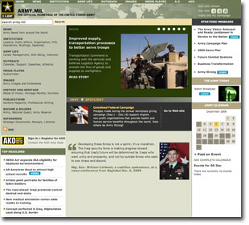

Semester C - Exit Profile
At the end of this semester, learner acquires the necessary knowledge and skills required for :
  Designing complex software systems
  Optimizing application performance
  Creating and deploying Web applications using ASP.NET
  Developing .NET Framework 2.0 based applications

Slide 4
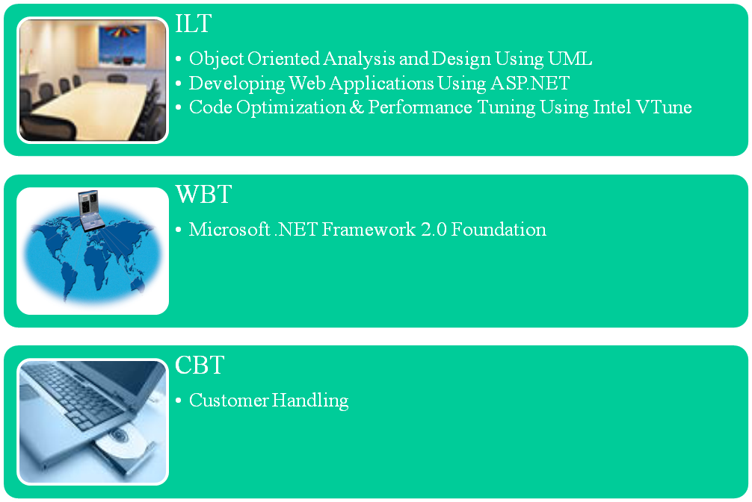
Course Structure
Notes:
Share the duration of courses with the students. In addition, tell students that they will be doing a Project. Database Application Developers possessing knowledge of Java applications and/or .NET applications, use database connectivity tools to write and retrieve data from and to the various data sources such as RDBMS or XML documents. The project will provide students to demonstrate the skills that they have acquired on database connectivity using Java and/or .NET applications to provide a solution in a given scenario.

Slide 5
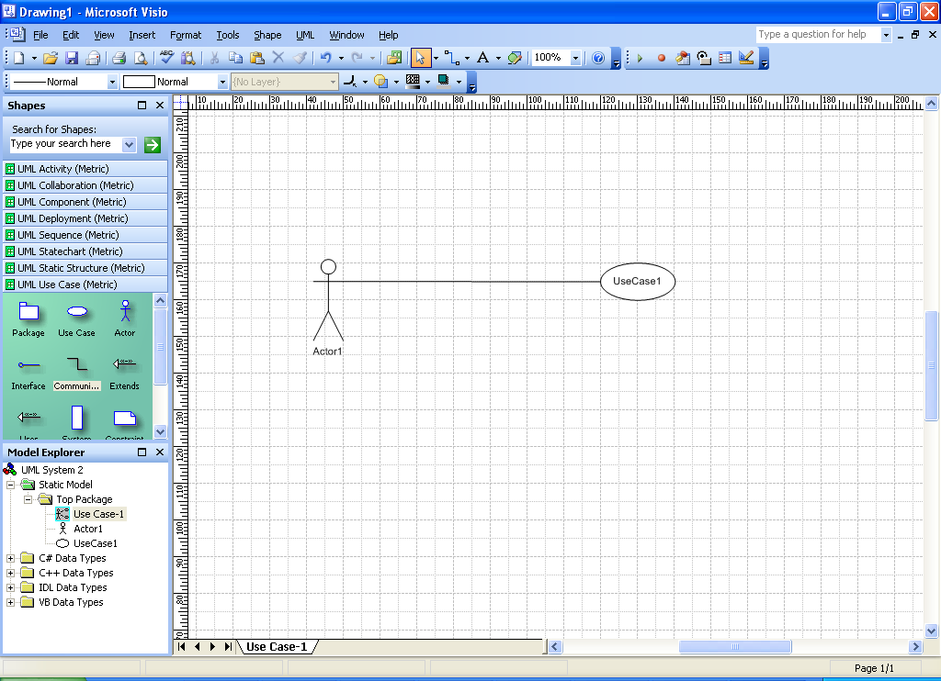
Course 1: Object Oriented Analysis and Design Using UML- Rationale
Enables you to efficiently analyze the existing business process and create the new software system.
Enables you to create the structure and design of an object-oriented system.
Enables the software designers to represent the sequence of activities that constitute the software process.
Enables the software architects to create modular design and effective software solutions.
Notes:
Tell students that a data structure is an implementation of an abstract data type with a well-defined set of operations. An algorithm is an explicit step-by-step procedure for producing a solution to a given problem.
Explain to the students that when appropriately chosen, data structures along with a related algorithm help solve programming problems efficiently. They also help create programs that use standard component and are hence simple, reusable, and easy to maintain. Appropriate algorithms also help in efficient execution time and memory usage in the application.
This course will enable a learner to select and implement an appropriate data structure and algorithm to solve a specific programming problem.

Slide 6
Course 1: Object Oriented Analysis and Design Using UML- Objectives
Identify the various software development approaches
Identify the need, scope, and building blocks of UML
Identify the types of UML diagrams
Analyze a problem by using business and system modeling
Set the system boundaries and project scope
Refine the system definition
Apply the basic concepts of static modeling
Create class and object diagrams
Identify various types of classes and the relationships between them
Identify Interfaces
Identify the concepts of dynamic modeling
Notes:
Share the objectives of the course with the students.

Slide 7
Course 1: Object Oriented Analysis and Design Using UML- Objectives
Create interaction, state machine, and activity diagrams
Create package, component, and deployment diagrams
Apply frameworks and patterns to design a software system
Generate code from a design model
Identify various dimensions of quality processes
Define extension mechanisms of UML
Measure the complexity of UML artifacts
Notes:
Share the objectives of the course with the students.

Slide 8
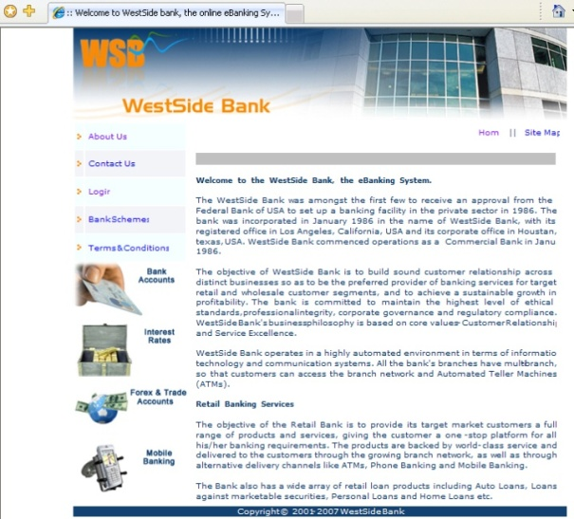
Course 2: Developing Web Applications Using ASP.NET- Rationale
With the increased use of the Internet and advances in information technology, website developers need to quickly create websites that are efficient and effective.
Microsoft’s ASP.NET 2.0 provides developers with various time saving and code saving features.
One of its key design goals is to make programming easier and quicker by reducing the amount of code. In addition, it contains several new server controls, which eliminate the need for writing voluminous code.
Notes:
Tell students that data interchange is essential to carry out business transactions. However, organizations store data in disparate formats, which makes the process of data interchange complex and time-consuming. Extensible Markup Language (XML) is a standard, simple way of storing the data in a format that can be exchanged across multiple systems across an enterprise. Providing an insight into XML will benefit students as it is a standard technology to describe and define documents.

Slide 9
Course 2: Developing Web Applications Using ASP.NET-Objectives
Create and Program Web applications.
Add and configure server controls for a Web application.
Use master pages to establish a common layout for a Web application.
Access and display data in a Web application.
Control access to a Web application.
Deploy a Web application.
Create a mobile Web application.
Build dynamic Web applications.
Create controls for Web applications.
Optimize Web applications.
Notes:
Share the objectives of the course with the students.

Slide 10
Course 2: Developing Web Applications Using ASP.NET-Objectives
Build customizable Web applications.
Build Web Part pages and Web Parts.
Notes:
Share the objectives of the course with the students.

Slide 11
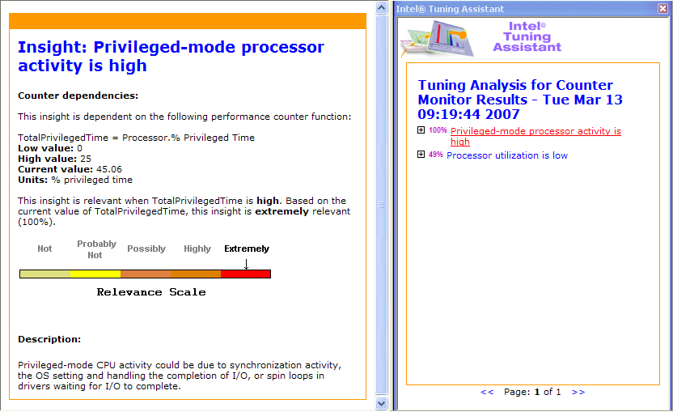
Course 3: Code Optimization & Performance Tuning Using Intel VTune- Rationale
Enables software developers to understand the various ways to optimize applications.
Enables software developers to make best use of available resources for performance enhancement.
Notes:
Tell students that Java is an object-oriented language that will enable them to create real world applications. The code reusability feature of Java enables the software developers to upgrade the existing applications without rewriting the entire code of the application.
Share the following points with students:
Applets and Swings in Java help in creating web-based applications. The Layout manager in Java enables a software developer to apply various types of border layout to the Web application. The concept of Multithreading enables the developer to build programs that use multiple system resources simultaneously.
The concept of working with files and I/O streams enables the software developers to store and retrieve the information from a flat or a text file. Packages enable the reusability of classes and methods across various applications.
Component technologies, such as JavaBeans, Servlets, and JSP use the service and communication technologies for implementing the functionality of enterprise applications.
JDBC is a service technology that provides database-independent connectivity between Java applications and different databases

Slide 12
Course 3: Code Optimization & Performance Tuning Using Intel VTune- Objectives
Identify the need and the levels of application optimization
Identify the application optimization process
Identify time and space complexity
Optimize programming constructs
Identify issues that affect memory performance
Identify issues that affect processor performance
Identify the features of VTune Performance Analyzer
Identify hotspots and bottlenecks in an application using sampling
Identify the program flow of an application using call graph
Notes:
Share the objectives of the course with the students.
Tell students that this course focuses on the basics of Java and core technologies that are implemented for developing distributed and enterprise applications in Java. This includes an introduction to Java Database Connectivity (JDBC) API databases, and moves on to the advance features of JDBC.
The course provides an introduction to object-oriented concepts and its implementation in Java technology programs. It covers the programming concepts and principles such as encapsulation, abstraction, inheritance, interfaces, polymorphism, and object association. This course also covers the fundamentals of Java programming language such as variables, literals, access specifiers, and modifiers.
The course also explains how to handle the exceptions in Java using the try and catch statement. This course also deals with the concept of applets, swings, and AWT components. It also deals with threads, garbage collection, and binary I/O stream classes.
Towards the end, the course covers JDBC and deals with accessing and querying a database using JDBC and how to perform transaction management, batch updates, and retrieval of metadata information using JDBC.

Slide 13
Course 3: Code Optimization & Performance Tuning Using Intel VTune- Objectives
Identify system-level performance issues using counter monitor
Use Tuning Assistant to obtain Tuning Advice reports
Collect and analyze performance data for remote applications
Identify methods for improving the performance of multithreaded applications
Use Intel VTune Performance Analyzer for threaded applications
Analyze remote performance data using VTune
Notes:
Share the objectives of the course with the students.
Tell students that this course focuses on the basics of Java and core technologies that are implemented for developing distributed and enterprise applications in Java. This includes an introduction to Java Database Connectivity (JDBC) API databases, and moves on to the advance features of JDBC.
The course provides an introduction to object-oriented concepts and its implementation in Java technology programs. It covers the programming concepts and principles such as encapsulation, abstraction, inheritance, interfaces, polymorphism, and object association. This course also covers the fundamentals of Java programming language such as variables, literals, access specifiers, and modifiers.
The course also explains how to handle the exceptions in Java using the try and catch statement. This course also deals with the concept of applets, swings, and AWT components. It also deals with threads, garbage collection, and binary I/O stream classes.
Towards the end, the course covers JDBC and deals with accessing and querying a database using JDBC and how to perform transaction management, batch updates, and retrieval of metadata information using JDBC.

Slide 14
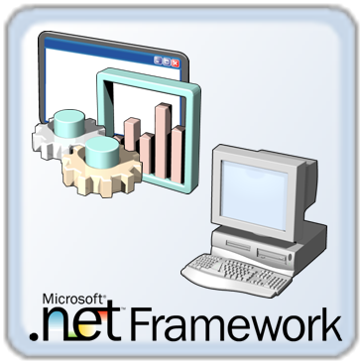
Course 4: Microsoft .NET Framework 2.0 Foundation - Rationale
Enables software developers to code using Microsoft .NET framework.
Enables improvements in code reuse, code specialization, resource management, multilanguage development, security, deployment, and administration.
Notes:
Tell students that Java is an object-oriented language that will enable them to create real world applications. The code reusability feature of Java enables the software developers to upgrade the existing applications without rewriting the entire code of the application.
Share the following points with students:
Applets and Swings in Java help in creating web-based applications. The Layout manager in Java enables a software developer to apply various types of border layout to the Web application. The concept of Multithreading enables the developer to build programs that use multiple system resources simultaneously.
The concept of working with files and I/O streams enables the software developers to store and retrieve the information from a flat or a text file. Packages enable the reusability of classes and methods across various applications.
Component technologies, such as JavaBeans, Servlets, and JSP use the service and communication technologies for implementing the functionality of enterprise applications.
JDBC is a service technology that provides database-independent connectivity between Java applications and different databases

Slide 15
Course 4: Microsoft .NET Framework 2.0 Foundation - Objectives
Implement system types and interfaces.
Implement collections and generics.
Configure and install assemblies.
Monitor and debug applications.
Read and write files.
Serialize data.
Create globalized applications.
Work with GDI+ in Windows-based applications.
Implement code access security.
Implement cryptography.
Interoperate between COM components and assemblies.
Implement delegates and events.
Notes:
Share the objectives of the course with the students.
Tell students that this course focuses on the basics of Java and core technologies that are implemented for developing distributed and enterprise applications in Java. This includes an introduction to Java Database Connectivity (JDBC) API databases, and moves on to the advance features of JDBC.
The course provides an introduction to object-oriented concepts and its implementation in Java technology programs. It covers the programming concepts and principles such as encapsulation, abstraction, inheritance, interfaces, polymorphism, and object association. This course also covers the fundamentals of Java programming language such as variables, literals, access specifiers, and modifiers.
The course also explains how to handle the exceptions in Java using the try and catch statement. This course also deals with the concept of applets, swings, and AWT components. It also deals with threads, garbage collection, and binary I/O stream classes.
Towards the end, the course covers JDBC and deals with accessing and querying a database using JDBC and how to perform transaction management, batch updates, and retrieval of metadata information using JDBC.

Slide 16
Course 4: Microsoft .NET Framework 2.0 Foundation (Contd.)
To access the WBT from the Microsoft Web Site, you need to perform the following steps:
  Open the following link in Microsoft Internet Explorer:
    https://www.microsoftelearning.com/eLearning/enterCode.aspx
  Sign In to the Web site with your Windows Live ID by clicking the Sign In button placed at the top-right hand side of the Web page. Incase you do not have Windows Live ID, you can create the same by clicking the Sign up now button on the Sign In page that is displayed.
  Select the I have read and accept the End User License Agreement. Click here to read the License Agreement checkbox.
  Enter the access code provided to you in the Access Code text box and click the Send button.
Notes:
Share the objectives of the course with the students.
Tell students that this course focuses on the basics of Java and core technologies that are implemented for developing distributed and enterprise applications in Java. This includes an introduction to Java Database Connectivity (JDBC) API databases, and moves on to the advance features of JDBC.
The course provides an introduction to object-oriented concepts and its implementation in Java technology programs. It covers the programming concepts and principles such as encapsulation, abstraction, inheritance, interfaces, polymorphism, and object association. This course also covers the fundamentals of Java programming language such as variables, literals, access specifiers, and modifiers.
The course also explains how to handle the exceptions in Java using the try and catch statement. This course also deals with the concept of applets, swings, and AWT components. It also deals with threads, garbage collection, and binary I/O stream classes.
Towards the end, the course covers JDBC and deals with accessing and querying a database using JDBC and how to perform transaction management, batch updates, and retrieval of metadata information using JDBC.

Slide 17
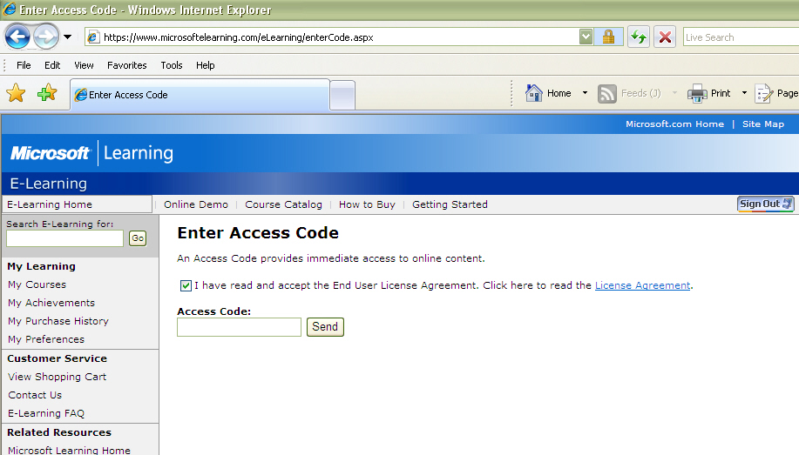
Course 4: Microsoft .NET Framework 2.0 Foundation (Contd.)
The Enter Access Code Web page:
Notes:
Share the objectives of the course with the students.
Tell students that this course focuses on the basics of Java and core technologies that are implemented for developing distributed and enterprise applications in Java. This includes an introduction to Java Database Connectivity (JDBC) API databases, and moves on to the advance features of JDBC.
The course provides an introduction to object-oriented concepts and its implementation in Java technology programs. It covers the programming concepts and principles such as encapsulation, abstraction, inheritance, interfaces, polymorphism, and object association. This course also covers the fundamentals of Java programming language such as variables, literals, access specifiers, and modifiers.
The course also explains how to handle the exceptions in Java using the try and catch statement. This course also deals with the concept of applets, swings, and AWT components. It also deals with threads, garbage collection, and binary I/O stream classes.
Towards the end, the course covers JDBC and deals with accessing and querying a database using JDBC and how to perform transaction management, batch updates, and retrieval of metadata information using JDBC.

Slide 18
Course 4: Microsoft .NET Framework 2.0 Foundation (Contd.)
Once you click the Send button, you will be taken to the Product Selection Web page.
Select the Collection 5160: Core Development with the Microsoft .NET Framework 2.0 Foundation radio button from the list of products provided in the Product Selection Web page and click the Submit button.
  Similarly, you can repeat these steps to activate another product. It must be noted that one access code can be used to activate only one product. To activate another product, you will need to enter a new access code.
Once you click the Submit button, you will be taken to another Web page and the data of expiration for the product selected by you will be displayed.
Notes:
Share the objectives of the course with the students.
Tell students that this course focuses on the basics of Java and core technologies that are implemented for developing distributed and enterprise applications in Java. This includes an introduction to Java Database Connectivity (JDBC) API databases, and moves on to the advance features of JDBC.
The course provides an introduction to object-oriented concepts and its implementation in Java technology programs. It covers the programming concepts and principles such as encapsulation, abstraction, inheritance, interfaces, polymorphism, and object association. This course also covers the fundamentals of Java programming language such as variables, literals, access specifiers, and modifiers.
The course also explains how to handle the exceptions in Java using the try and catch statement. This course also deals with the concept of applets, swings, and AWT components. It also deals with threads, garbage collection, and binary I/O stream classes.
Towards the end, the course covers JDBC and deals with accessing and querying a database using JDBC and how to perform transaction management, batch updates, and retrieval of metadata information using JDBC.

Slide 19
Course 4: Microsoft .NET Framework 2.0 Foundation (Contd.)
Click the My Learning link provided on the Web page to view your online content. You will be taken to the Learning Manager page.
The courses available in the selected product will be displayed. To launch a particular course, select the Launch E-Learning option from the drop down list placed against each course and click the Go button. The Web page corresponding to the particular course will open.
Click the Begin This Course button. The WBT for the course opens in a new window.
Notes:
Share the objectives of the course with the students.
Tell students that this course focuses on the basics of Java and core technologies that are implemented for developing distributed and enterprise applications in Java. This includes an introduction to Java Database Connectivity (JDBC) API databases, and moves on to the advance features of JDBC.
The course provides an introduction to object-oriented concepts and its implementation in Java technology programs. It covers the programming concepts and principles such as encapsulation, abstraction, inheritance, interfaces, polymorphism, and object association. This course also covers the fundamentals of Java programming language such as variables, literals, access specifiers, and modifiers.
The course also explains how to handle the exceptions in Java using the try and catch statement. This course also deals with the concept of applets, swings, and AWT components. It also deals with threads, garbage collection, and binary I/O stream classes.
Towards the end, the course covers JDBC and deals with accessing and querying a database using JDBC and how to perform transaction management, batch updates, and retrieval of metadata information using JDBC.

Slide 20
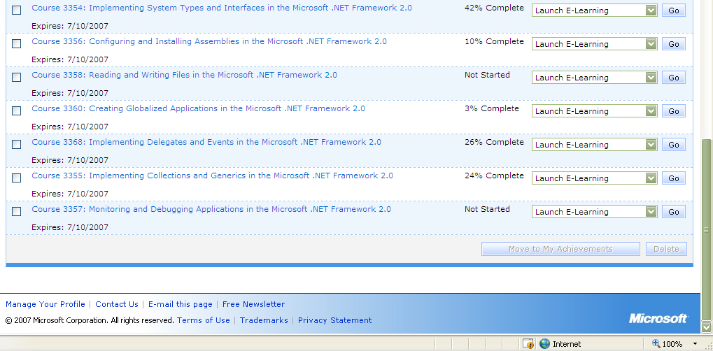
Course 4: Microsoft .NET Framework 2.0 Foundation (Contd.)
The courses available under the product selected by you are displayed as following:
Notes:
Share the objectives of the course with the students.
Tell students that this course focuses on the basics of Java and core technologies that are implemented for developing distributed and enterprise applications in Java. This includes an introduction to Java Database Connectivity (JDBC) API databases, and moves on to the advance features of JDBC.
The course provides an introduction to object-oriented concepts and its implementation in Java technology programs. It covers the programming concepts and principles such as encapsulation, abstraction, inheritance, interfaces, polymorphism, and object association. This course also covers the fundamentals of Java programming language such as variables, literals, access specifiers, and modifiers.
The course also explains how to handle the exceptions in Java using the try and catch statement. This course also deals with the concept of applets, swings, and AWT components. It also deals with threads, garbage collection, and binary I/O stream classes.
Towards the end, the course covers JDBC and deals with accessing and querying a database using JDBC and how to perform transaction management, batch updates, and retrieval of metadata information using JDBC.

Slide 21
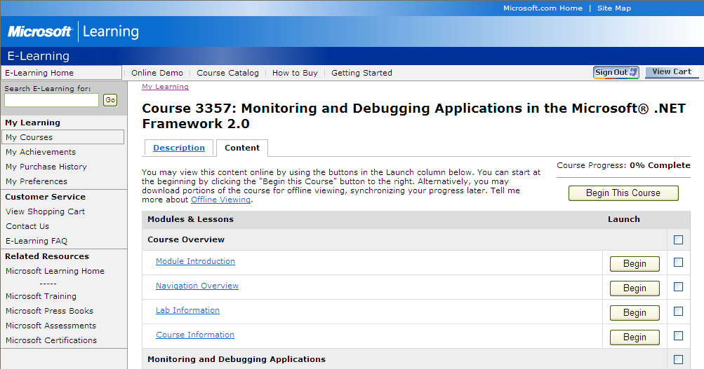
Course 4: Microsoft .NET Framework 2.0 Foundation (Contd.)
After selecting the Launch E-Learning option and clicking the Go button, the Web page for the course will be displayed as following:
Notes:
Share the objectives of the course with the students.
Tell students that this course focuses on the basics of Java and core technologies that are implemented for developing distributed and enterprise applications in Java. This includes an introduction to Java Database Connectivity (JDBC) API databases, and moves on to the advance features of JDBC.
The course provides an introduction to object-oriented concepts and its implementation in Java technology programs. It covers the programming concepts and principles such as encapsulation, abstraction, inheritance, interfaces, polymorphism, and object association. This course also covers the fundamentals of Java programming language such as variables, literals, access specifiers, and modifiers.
The course also explains how to handle the exceptions in Java using the try and catch statement. This course also deals with the concept of applets, swings, and AWT components. It also deals with threads, garbage collection, and binary I/O stream classes.
Towards the end, the course covers JDBC and deals with accessing and querying a database using JDBC and how to perform transaction management, batch updates, and retrieval of metadata information using JDBC.

Slide 22
Course 4: Microsoft .NET Framework 2.0 Foundation (Contd.)
After you have activated the product by performing the preceding steps, you can access the WBT by performing the following steps whenever required:
  Open the following link in Microsoft Internet Explorer:
    https://www.microsoftelearning.com
  Sign In to the Web site with your Windows Live ID by clicking the Sign In button placed at the top-right hand side of the Web page.
  Click the My Courses link in the left pane of the Web site under the My Learning section. The courses activated by you will be displayed which you can browse.
Click the Sign Out button when you need to end your session and log off from the Web site.
Notes:
Share the objectives of the course with the students.
Tell students that this course focuses on the basics of Java and core technologies that are implemented for developing distributed and enterprise applications in Java. This includes an introduction to Java Database Connectivity (JDBC) API databases, and moves on to the advance features of JDBC.
The course provides an introduction to object-oriented concepts and its implementation in Java technology programs. It covers the programming concepts and principles such as encapsulation, abstraction, inheritance, interfaces, polymorphism, and object association. This course also covers the fundamentals of Java programming language such as variables, literals, access specifiers, and modifiers.
The course also explains how to handle the exceptions in Java using the try and catch statement. This course also deals with the concept of applets, swings, and AWT components. It also deals with threads, garbage collection, and binary I/O stream classes.
Towards the end, the course covers JDBC and deals with accessing and querying a database using JDBC and how to perform transaction management, batch updates, and retrieval of metadata information using JDBC.

